Slide 1


DATABASE NORMALIZATION

Slide 2

WHAT IS NORMALIZATION
Normalization is the process of organizing the data in the database.
Normalization is used to minimize the redundancy from a relation or set of relations. It is also used to eliminate undesirable characteristics like Insertion, Update, and Deletion Anomalies.
Normalization divides the larger table into the smaller table and links them using a relationship.
The normal form is used to reduce redundancy from the database table.

Slide 3
CONTINUE…
Normalization organizes the columns and tables of a database to ensure that database integrity constraints properly execute their dependencies.
It is a systematic technique of decomposing tables to eliminate data redundancy (repetition) and undesirable characteristics like Insertion, Update, and Deletion anomalies.
In this process, we normalize the table where the data in columns can be fetched with a key.

Slide 4
What is a KEY in SQL?
Key is a value used to identify the data in records differently.
SQL key is beneficial when there are various columns in the table, and we need to identify a single or group of columns.
SQL KEY helps identify the column that requires to be extracted from the database. We can also identify duplicate data in the table by using SQL KEY.
The relationships among different tables or columns are established by using the SQL key. These relationships create a difference between the tables or columns.
As we know, SQL keys are used to identify columns uniquely, but some columns don’t have a SQL key and can’t be identified with a key. So, these columns are called non-key columns.

Slide 5
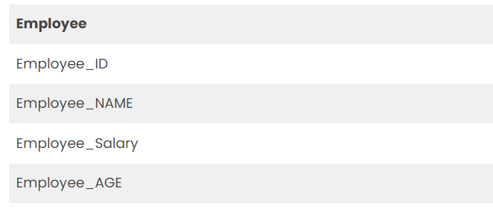
Database – Primary Key
The primary key is very useful when we need to identify only one value from the entity. However, the entity may contain various keys, but the most suitable key is called the Primary Key.
For example, the key that can be used to identify an employee in an Employee table can be Employee ID, as it is different for every entry in the table. So, we can make Employee ID the Primary Key in this case.
Now the selection of an employee can be made by using the primary key.

Slide 6
Database – Composite Key
The composite Key becomes useful when there are more attributes in the Primary Key.
For example, let us talk about the same table we discussed above the Employee table. Suppose the employees are given different Project Ids and roles that can help them uniquely identify from the table.
Now, the employee can be identified with the help of any of the keys such as Employee_ID, Employee_ProjectID, or Employee_ROLE. So, there are multiple primary keys.
When a primary key has more attributes to be considered, it is called a composite key. Therefore, combining all these keys is called Composite Key or Concatenated Key.

Slide 7
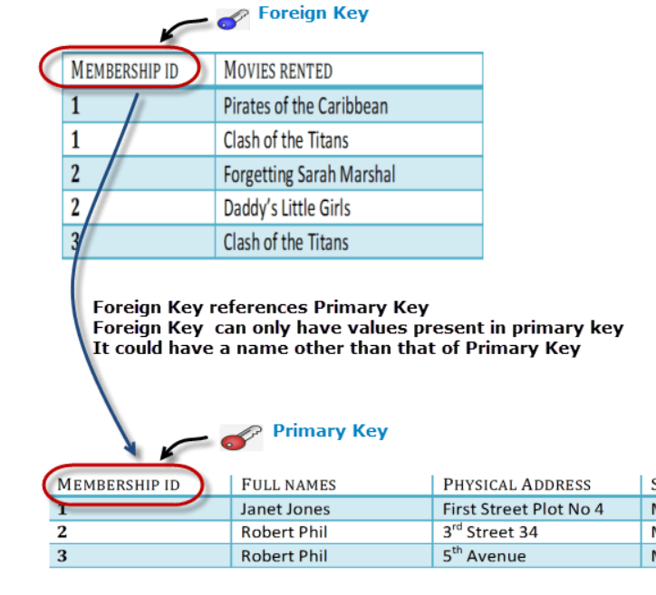
Database – Foreign Key
Foreign Key references the primary key of another Table! It helps connect your Tables.
A foreign key can have a different name from its primary key.
It ensures rows in one table have corresponding rows in another.
Foreign keys can be null even though primary keys can not.

Slide 8
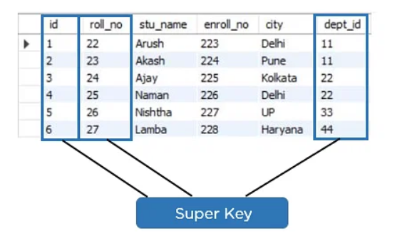
Super Key
Super key is a set of over one key that can identify a record uniquely in a table, and the Primary Key is a subset of the Super Key.

Slide 9
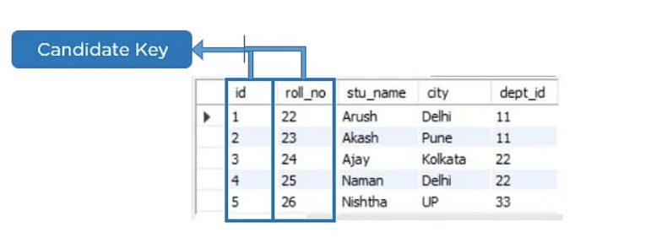
Candidate Key
A candidate key is a set of one or more columns that can identify a record uniquely in a table, and YOU can use each candidate key as a Primary Key.

Slide 10
What is Anomaly?
In Database Management System (DBMS), anomaly means the inconsistency occurred in the relational table during the operations performed on the relational table.
There can be various reasons for anomalies to occur in the database.
For example, if there is a lot of redundant data present in our database then DBMS anomalies can occur. If a table is constructed in a very poor manner, then there is a chance of database anomaly. Due to database anomalies, the integrity of the database suffers.
The other reason for the database anomalies is that all the data is stored in a single table. So, to remove the anomalies of the database, normalization is the process that is done where the splitting of the table and joining of the table (different types of join) occurs.

Slide 11
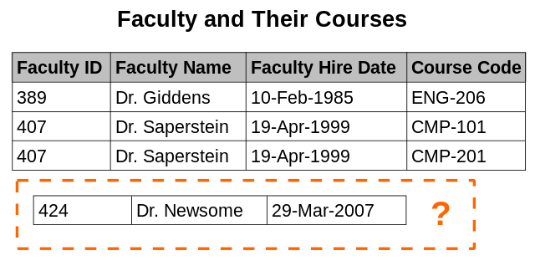
Insertion anomaly
There are circumstances in which certain facts cannot be recorded at all.
For example, each record in a "Faculty and Their Courses" relation might contain a Faculty ID, Faculty Name, Faculty Hire Date, and Course Code. Therefore, the details of any faculty member who teaches at least one course can be recorded, but a newly hired faculty member who has not yet been assigned to teach any courses cannot be recorded, except by setting the Course Code to null.

Slide 12
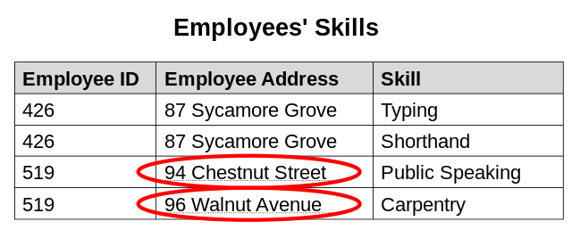
Update anomaly
The same information can be expressed on multiple rows; therefore, updates to the relationship may result in logical inconsistencies.
For example, each record in an "Employees' Skills" relation might contain an Employee ID, Employee Address, and Skill; thus, a change of address for a particular employee may need to be applied to multiple records (one for each skill). If the update is only partially successful – the employee's address is updated on some records but not others – then the relation is left in an inconsistent state. Specifically, the relation provides conflicting answers to the question of what this particular employee's address is.

Slide 13
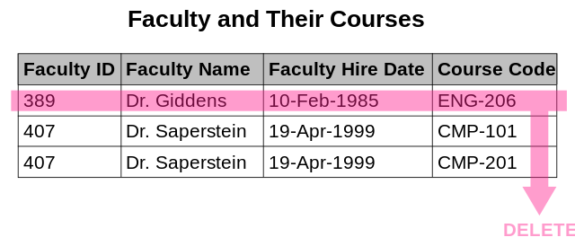
Deletion anomaly
Under certain circumstances, the deletion of data representing certain facts necessitates the deletion of data representing completely different facts. The "Faculty and Their Courses" relation described in the previous example suffers from this type of anomaly, for if a faculty member temporarily ceases to be assigned to any courses, the last of the records on which that faculty member appears must be deleted, effectively also deleting the faculty member, unless the Course Code field is set to null.

Slide 14
Functional Dependency
Functional dependency is a relationship that exists between two attributes.
It typically exists between the primary key and non-key attribute within a table.
X → Y
The left side of FD is known as a determinant, and the right side of the production is known as a dependent.

Slide 15

For example:
Assume we have an employee table with attributes: Emp_Id, Emp_Name, Emp_Address.
Here Emp_Id attribute can uniquely identify the Emp_Name attribute of the employee table because if we know the Emp_Id, we can tell that the employee's name is associated with it.
Functional dependency can be written as:
Emp_Id → Emp_Name
We can say that Emp_Name is functionally dependent on Emp_Id.

Slide 16
Types of Functional dependency
Functional Dependency
MULTIVALUED
TRIVIAL
NON-TRIVIAL
TRANSITIVE

Slide 17
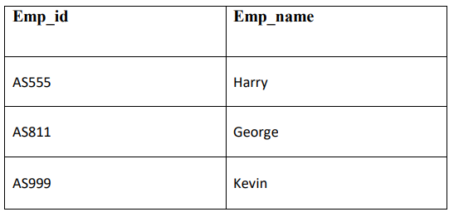
Trivial functional dependency
A → B has trivial functional dependency if B is a subset of A.
The following dependencies are also trivial like A → A, B → B.
Example:
Consider a table with two columns Employee_Id and Employee_Name.
{Employee_id, Employee_Name} → Employee_Id is a trivial functional dependency as Employee_Id is a subset of {Employee_Id, Employee_Name}.

Slide 18
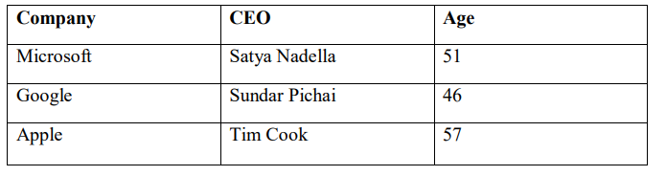
Non-trivial functional dependency
A → B has a non-trivial functional dependency if B is not a subset of A.
When A intersection B is NULL, then A → B is called a complete non-trivial.
Example:
(Company} -> {CEO} (if we know the Company, we know the CEO name)
But the CEO is not a subset of the Company; hence, it’s a non-trivial functional dependency.

Slide 19
Transitive dependency
A transitive dependency refers to some non-prime attribute other than the candidate key that depends on another non-prime attribute that is dependent entirely on the candidate key.
{Company} -> {CEO} (if we know the company, we know its CEO's name)
{CEO } -> {Age} If we know the CEO, we know the Age
Therefore, according to the rule of transitive dependency:
{ Company} -> {Age} should hold, that makes sense because if we know the company name, we can know his age.
Note: You need to remember that transitive dependency can only occur in relation to three or more attributes.

Slide 20
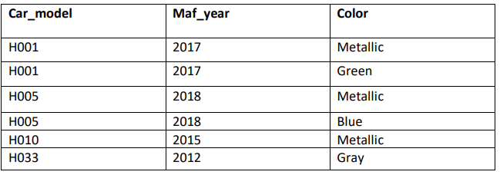
Multivalued dependency
Multivalued dependency occurs in the situation where there are multiple independent multivalued attributes in a single table. A multivalued dependency is a complete constraint between two sets of attributes in a relation. It requires that certain tuples be present in a relation.
In this example, maf_year and color are independent of each other but dependent on car_model. In this example, these two columns are said to be multivalue dependent on car_model.
This dependence can be represented like this:
car_model -> maf_year
car_model-> colour

Slide 21
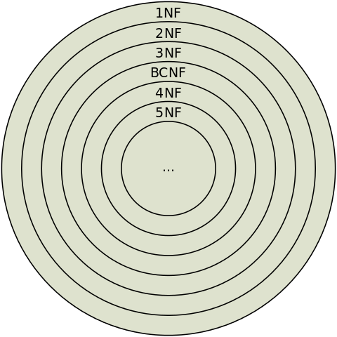
Types of Normal Forms
First Normal Form (1NF)
Second Normal Form (2NF)
Third Normal Form (3NF)
Boyce Codd Normal Form (BCNF)
Fourth Normal Form (4NF)
Fifth Normal Form (5NF)
This Photo by Unknown Author is licensed under CC BY-SA

Slide 22

First Normal Form (1NF)
A relation will be 1NF if it contains an atomic value.
It states that an attribute of a table cannot hold multiple values. It must hold only single-valued attributes.
First normal form disallows the multi-valued attribute, composite attribute, and their combinations.

Slide 23
EXAMPLE1.
EMP_ID | EMP_NAME | EMP_PHONE | EMP_STATE
14 | John | 7272826385, 9064738238 | UP
20 | Harry | 8574783832 | Bihar
12 | Sam | 7390372389, 8589830302 | Punjab
Relation EMPLOYEE is not in 1NF because of multi-valued attribute EMP_PHONE.

Slide 24
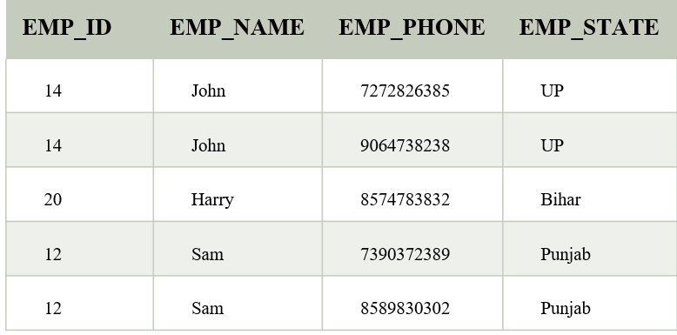
CONTINUE…
The decomposition of the EMPLOYEE table into 1NF has been shown

Slide 25
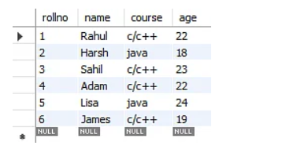
EXAMPLE 2.
Students’ record table that has information about student roll number, student name, student course, and age of the student.
In the student’s record table, you can see that the course column has two values. Thus, it does not follow the First Normal Form

Slide 26
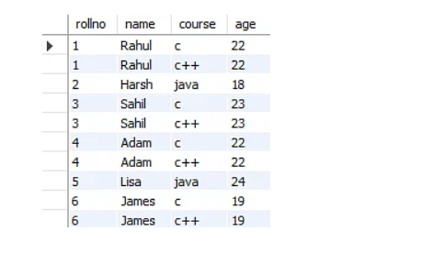
CONTINUE…
Now, if you use the First Normal Form in the above table, you get the given table as a result.

Slide 27
Second Normal Form (2NF)
In the 2NF, relational must be in 1NF.
In the second normal form, all non-key attributes are fully functionally dependent on the primary key.
It should be noted that the table should not contain any partial dependency, where partial dependency means a proper subset of the candidate key.
Example:
Let's assume, a school can store the data of teachers and the subjects they teach. In a school, a teacher can teach more than one subject

Slide 28
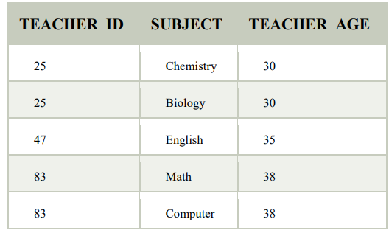
CONTINUE…
TEACHER Table
In the given table, the non-prime attribute TEACHER_AGE is dependent on TEACHER_ID which is a proper subset of a candidate key. That's why it violates the rule for 2NF.

Slide 29
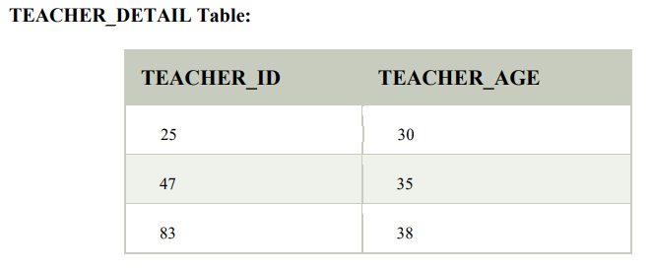
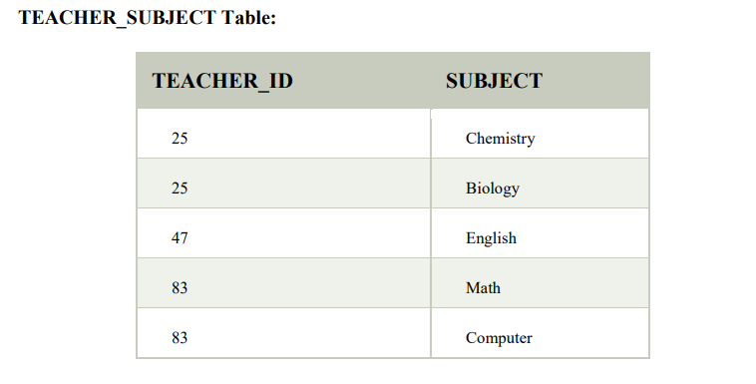
CONTINUE…
To convert the given table into 2NF, we decompose it into two tables:

Slide 30

EXAMPLE 2.
Consider the table Location
The Location table possesses a composite primary key cust_id, storied. The non-key attribute is store_location. In this case, store_location only depends on storeid, which is a part of the primary key. Hence, this table does not fulfill the second normal form.

Slide 31
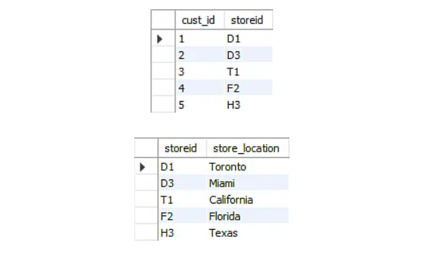
CONTINUE…
To bring the table to its Second Normal Form, we need to split the table into two parts.
As we have removed the partial functional dependency from the location table, the column store_location entirely depends on the primary key of that table, storeid.

Slide 32
Third Normal Form (3NF)
A relation will be in 3NF if it is in 2NF and does not contain any transitive dependency.
3NF is used to reduce data duplication. It is also used to achieve data integrity.
If there is no transitive dependency for non-prime attributes (which are not a part of the candidate key), then the relationship must be in the third normal form.
A relation is in third normal form if it holds at least one of the following conditions for every non-trivial function dependency X → Y.

Slide 33
CONTINUE…
The Third Normal Form ensures the reduction of data duplication.
It is also used to achieve data integrity.

Slide 34
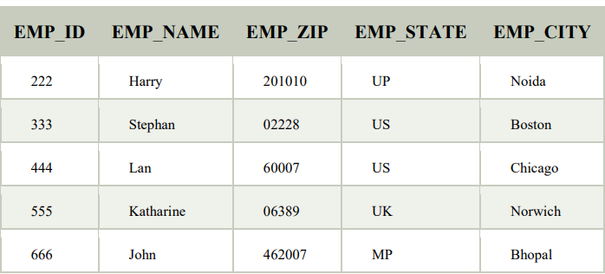
CONTINUE…
X is a super key.
2. Y is a prime attribute, i.e., each element of Y is part of some candidate key.
Example1: EMPLOYEE_DETAIL Table
Super key in the table
{EMP_ID}, {EMP_ID, EMP_NAME}, {EMP_ID, EMP_NAME, EMP_ZIP}....so on
Candidate key:
{EMP_ID}

Slide 35
CONTINUE…
Non-prime attributes: In the given table, all attributes except EMP_ID are nonprime.
Here, EMP_STATE & EMP_CITY dependent on EMP_ZIP and EMP_ZIP dependent on EMP_ID. The non-prime attributes (EMP_STATE, EMP_CITY) are transitively dependent on the super key(EMP_ID). It violates the rule of the third normal form.
That's why we need to move the EMP_CITY and EMP_STATE to the new table, with EMP_ZIP as a Primary key.

Slide 36
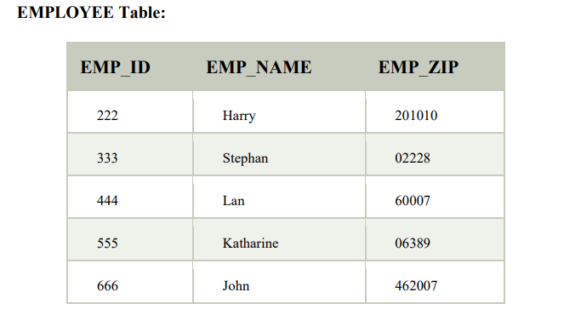
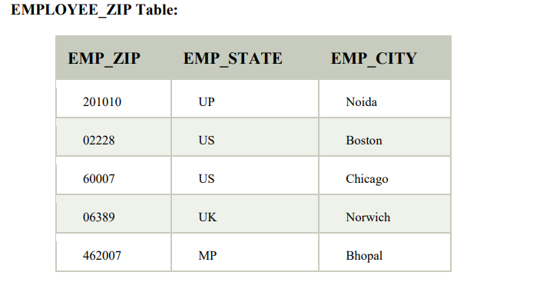
CONTINUE…

Slide 37
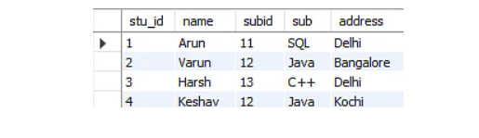
EXAMPLE 2.
Student table that has student id, student name, subject id, subject name, and address of the student as its columns.
Student table, stu_id determines subid, and subid determines sub. Therefore, stu_id determines sub via subid. This implies that the table possesses a transitive functional dependency, and it does not fulfill the third normal form criteria.

Slide 38
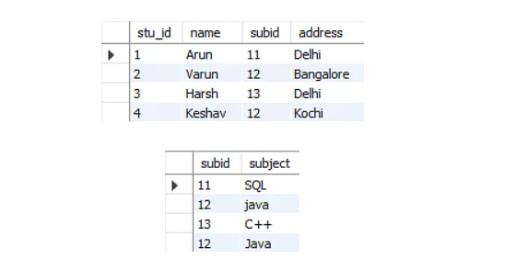
CONTINUE…
Now to change the table to the third normal form, you need to divide the table as shown.
As you can see in both tables, all the non-key attributes are now fully functional, dependent only on the primary key. In the first table, column names, subid, and addresses only depend on stu_id. In the second table, the sub only depends on subid.

Slide 39
Boyce Codd Normal Form (BCNF)
BCNF is the advanced version of 3NF.
It is stricter than 3NF.
A table is in BCNF if every functional dependency X → Y, X is the super key of the table.
For BCNF, the table should be in 3NF, and for every FD, LHS is super key.

Slide 40
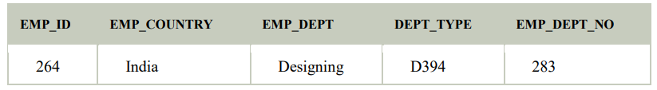
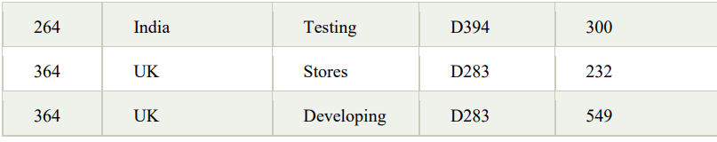
CONTINUE…
Example: Let's assume there is a company where employees work in more than one department.

Slide 41
CONTINUE…
In the above table Functional dependencies are as follows:
1. EMP_ID → EMP_COUNTRY
2. EMP_DEPT → {DEPT_TYPE, EMP_DEPT_NO}
Candidate key:
{EMP-ID, EMP-DEPT}
The table is not in BCNF because neither EMP_DEPT nor EMP_ID alone are keys
To convert the given table into BCNF, we decompose it into three tables.

Slide 42
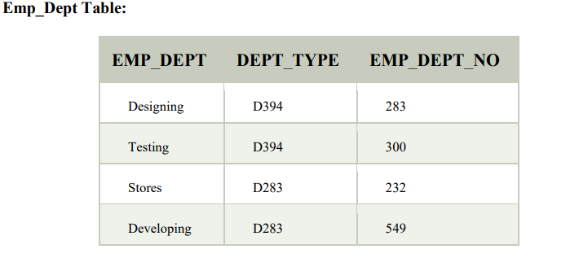
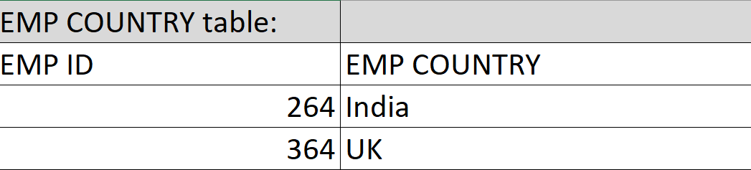
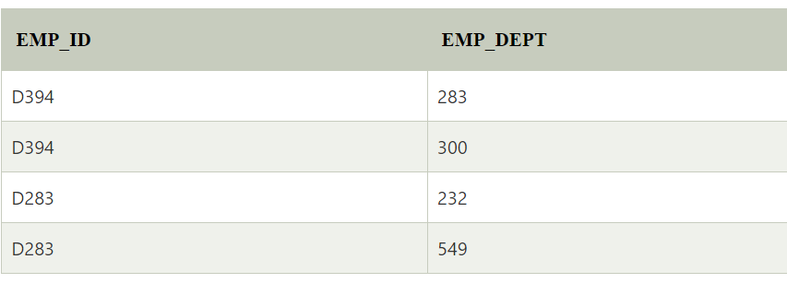
CONTINUE…

Slide 43
CONTINUE…
Functional dependencies:
EMP_ID → EMP_COUNTRY
EMP_DEPT → {DEPT_TYPE, EMP_DEPT_NO}
Candidate keys:
For the first table: EMP_ID
For the second table: EMP_DEPT
For the third table: {EMP_ID, EMP_DEPT}
Now, this is in BCNF because the left side part of both the functional dependencies is key.

Slide 44
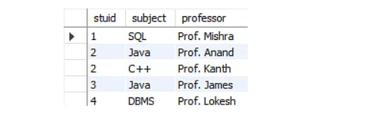
EXAMPLE 2.
Consider the subject table
The subject table follows these conditions:
Each student can enroll in multiple subjects.
Multiple professors can teach a particular subject.
For each subject, it assigns a professor to the student
The table is in 1st Normal form as all the column names are unique, all values are atomic, and all the values stored in a particular column are of the same domain.
The table also satisfies the 2nd Normal Form, as there is no Partial Dependency.
And there is no Transitive Dependency; hence, the table also satisfies the 3rd Normal Form.

Slide 45
CONTINUE…
This table follows all the Normal forms except the Boyce Codd Normal Form.
As you can see stuid, and subject form the primary key, which means the subject attribute is a prime attribute.
However, there exists yet another dependency - professor → subject.
BCNF does not follow in the table as a subject is a prime attribute, and the professor is a non-prime attribute.

Slide 46
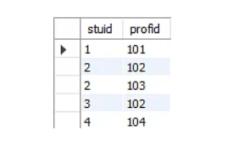
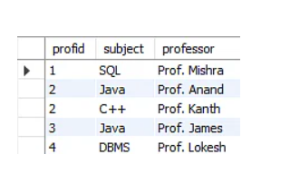
CONTINUE…
To transform the table into the BCNF, you will divide the table into two parts. One table will hold stuid which already exists, and the second table will hold a newly created column profid.
And in the second table will have the columns profid, subject, and professor, which satisfies the BCNF.

Slide 47

Fourth Normal Form (4NF)
A relation will be in 4NF if it is in Boyce Codd’s normal form and has no multi-valued dependency.
For a dependency A → B, if for a single value of A, multiple values of B exist, then the relationship will be a multi-valued dependency.
The given STUDENT table is in 3NF, but the COURSE and HOBBY are two independent entities. Hence, there is no relationship between COURSE and HOBBY.
In the STUDENT relation, a student with STU_ID 21 contains two courses, Computer and Math, and two hobbies, Dancing and Singing. So, there is a Multi-valued dependency on STU_ID, which leads to unnecessary repetition of data.
So, to make the above table into 4NF, we can decompose it into two tables

Slide 48

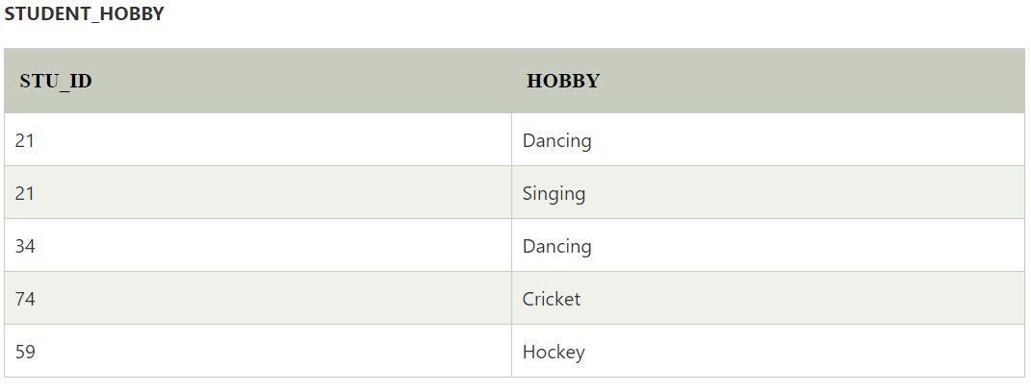
CONTINUE…

Slide 49
Fifth normal form (5NF)
A relation is in 5NF if it is in 4NF and not contains any join dependency and joining should be lossless.
5NF is satisfied when all the tables are broken into as many tables as possible in order to avoid redundancy.
5NF is also known as Project-join normal form (PJ/NF).

Slide 50

CONTINUE…
In the table, John takes both Computer and Math classes for Semester 1, but he doesn't take a Math class for Semester 2. In this case, a combination of all these fields is required to identify valid data.
Suppose we add a new Semester as Semester 3 but do not know about the subject and who will be taking that subject, so we leave Lecturer and Subject as NULL. But all three columns together act as a primary key, so we can't leave the other two columns blank.
So , to make the above table into 5NF, we can decompose it into three relations P1, P2 & P3:

Slide 51



CONTINUE…

Slide 52
Advantages of Normalization
Normalization helps to minimize data redundancy.
Greater overall database organization.
Data consistency within the database.
Much more flexible database design.
Enforces the concept of relational integrity.

Slide 53
Disadvantages of Normalization
You cannot start building the database before knowing what the user needs.
The performance degrades when normalizing the relations to higher normal forms, i.e., 4NF, 5NF.
It is very time-consuming and difficult to normalize relations of a higher degree.
Careless decomposition may lead to a bad database design, leading to serious problems.

Slide 54
Thank You

